Slide 1

Chapter 9
GUI Programming Using Tkinter

Slide 2
Motivations
Tkinter is not only a useful tool for developing GUI projects, but also a valuable pedagogical tool for learning object-oriented programming.

Slide 3
Objectives
To create a simple GUI application using Tkinter (§9.2).
To process events using callback functions bound to widget’s command option (§9.3).
To use a variety of widget classes to create widgets (§9.4).
To use labels, entries, buttons, check buttons, radio buttons, messages, and texts to create graphical user interfaces (§9.4).
To draw lines, rectangles, ovals, polygons, and arcs and display strings in a canvas (§9.5).
To encapsulate data fields to make classes easy to maintain (§9.5).
To layout widgets in a container using the geometry managers (§9.6).
To pack widgets side-by-side or a top of each other using the pack manager (§9.6.1).
To layout widgets in a grid using the grid manager (§9.6.2).
To place widgets in absolute locations using the manager (§9.6.3).
To use containers to group widgets to achieve desired layout (§9.7).
To use images in widgets (§9.8).
To create applications using menus (§9.9).
To create applications using popup menus (§9.10).
To bind mouse and key event on a widget to a callback function for processing events (§9.11).
To develop animations (§9.12).
To use scrollbars to scroll contents in a Text widget (§9.13).
To use standard dialog boxes for display messages and receive input (§9.14).

Slide 4
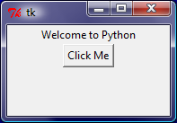
Getting Started with Tkinter
Getting started with Tkinter with a simple example.
SimpleGUI
Run

Slide 5
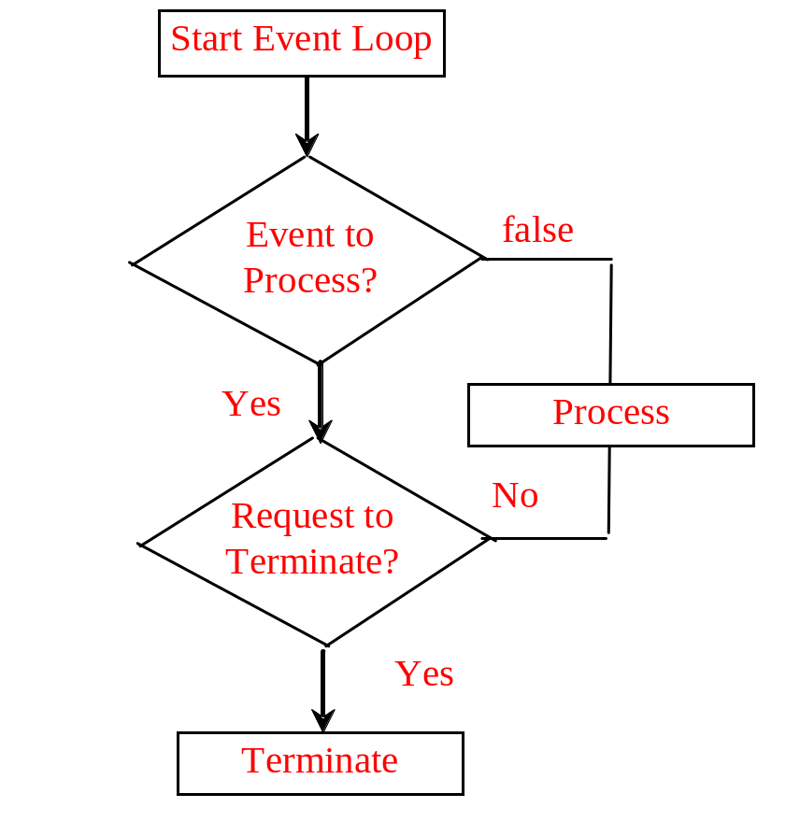

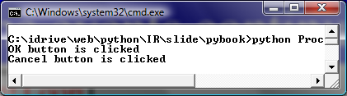
Processing Events
window.mainloop() # Create an event loop
The statement creates an event loop. The event loop processes the events continuously.
ProcessButtonEvent
Run

Slide 6
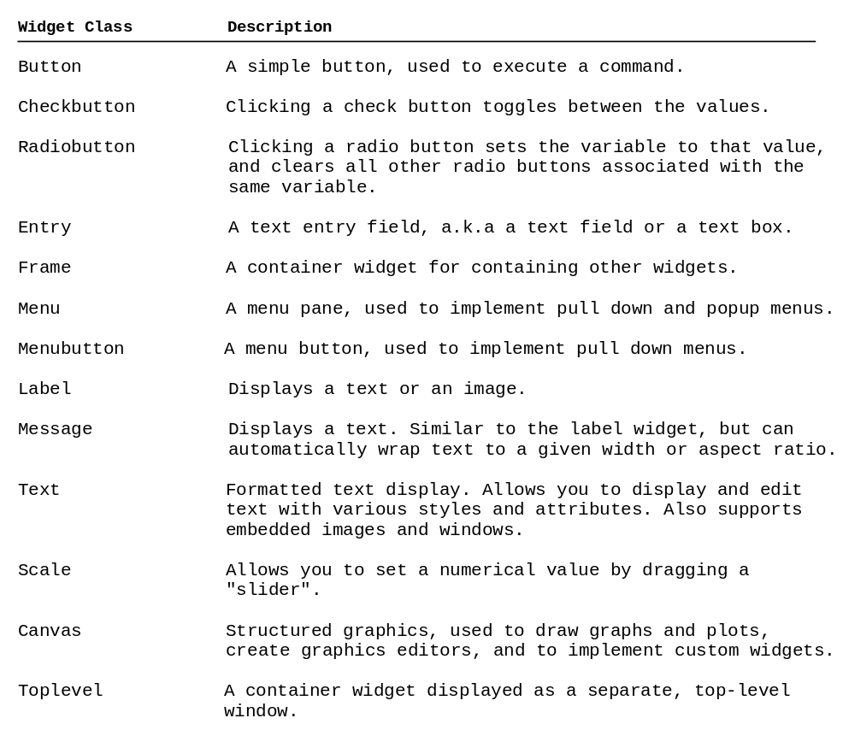
The Widget Classes

Slide 7
Color and Font
To specify a color, you can either use a color name such as red, yellow, green, blue, white, black, purple, etc, or explicitly specify the red, green, and blue (RGB) color components using a string #RRGGBB, where RR, GG, BB are hexadecimal representations of the red, green and blue values, respectively.
"Times 10 bold"
"Helvetica 10 bold italic"
"Courier New 20 bold italic"
"Courier New 20 bold italic over strike underline"

Slide 8
Text Formatting
The text in a label and a button is centered by default. You can change it by using the justify option with values LEFT, CENTER, or RIGHT. You can also display the text in multiple lines by inserting the newline character \n to separate texts.

Slide 9
Mouse Cursor
You can set a mouse cursor by using the cursor option with values such as "arrow" (default), "circle", "cross" "plus", etc.

Slide 10
Change Properties
widgetName["propertyName] = newPropertyValue
btShowOrHide = Button(window, text = "Show", bg = "white")
btShowOrHide["text"] = "Hide"
btShowOrHide["bg"] = "red"
btShowOrHide["fg"] = "#AB84F9" # Change fg color to #AB84F9
btShowOrHide["cursor"] = "plus" # Change mouse cursor to plus

Slide 11
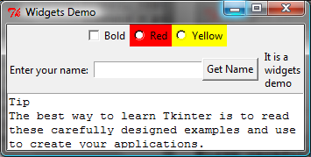
Widget Demo
WidgetsDemo
Run

Slide 12
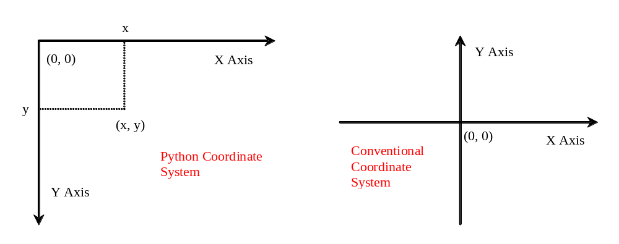
Canvas
Canvas can be used to display shapes. You can use the method such as create_rectangle, create_oval, create_arc, create_polygon, and create_line to draw a rectangle, oval, arc, polygon, and line on a canvas.

Slide 13
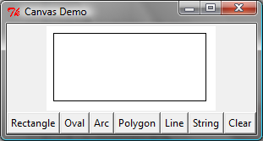
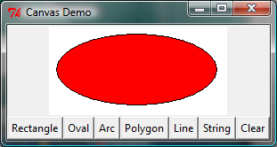
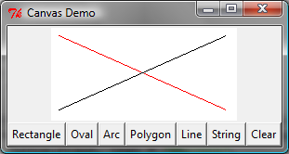
Canvas Demo
CanvasDemo
Run

Slide 14
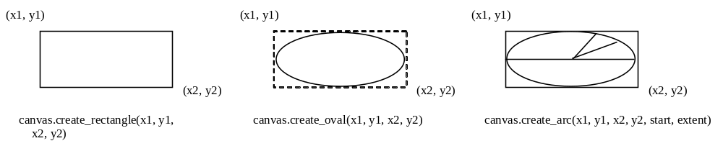
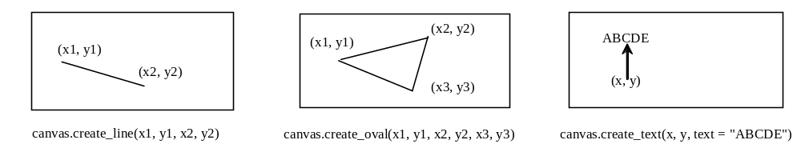
Drawing Methods

Slide 15
Geometry Managers
Grid Manager
Pack Manager
Place Manager
Since each manager has its own style of placing the widget, it is not a good practice to mix the managers for the widgets in the same container. You can use a frame as a subcontainer to achieve desired layout.

Slide 16
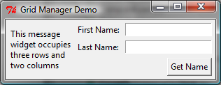
Grid Managers
GridManagerDemo
Run

Slide 17
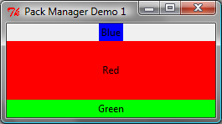
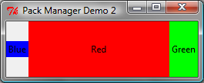
Pack Managers
PackManagerDemo1
Run
PackManagerDemo2
Run

Slide 18
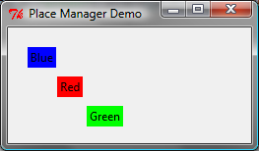
Place Managers
PlaceManagerDemo
Run

Slide 19
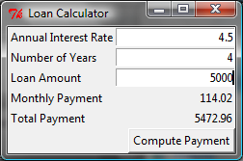
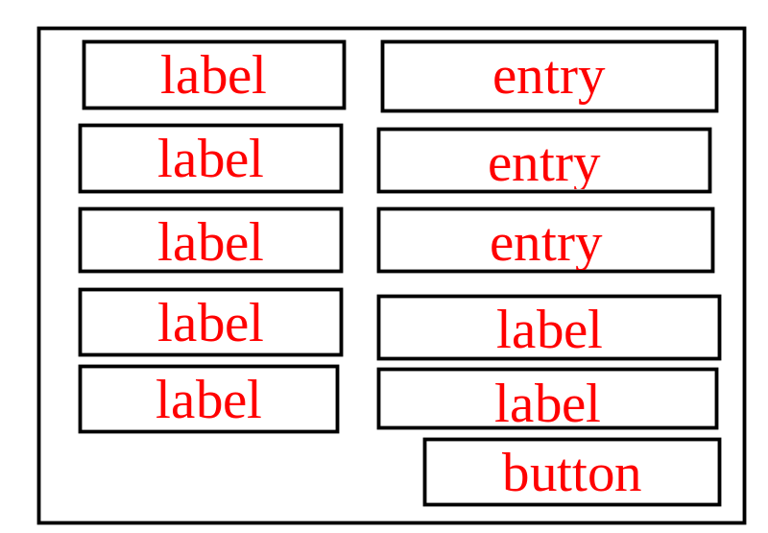
Case Study: Loan Calculator
LoanCalculator
Run

Slide 20
Display Images
You can add an image in a label, button, check button, and radio button. To create an image, use the PhotoImage class as follows:
photo = PhotoImage(file = imagefilename)
The image file must be GIF. You can use a conversion utility to convert image files in other format into GIF.

Slide 21
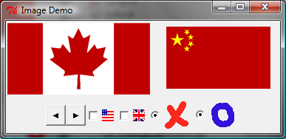
Image Example
ImageDemo
Run

Slide 22
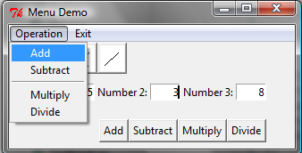
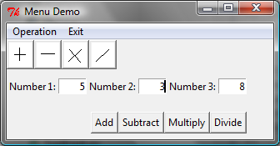
Menus
Tkinter provides a comprehensive solution for building graphical user interfaces.
MenuDemo
Run

Slide 23
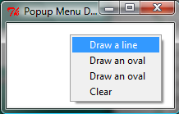
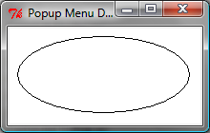
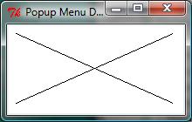
Popup Menus
PopupMenuDemo
Run

Slide 24
Mouse and Key Events
widget.bind(event, handler)
def popup(event):
menu.post(event.x_root, event.y_root)

Slide 25
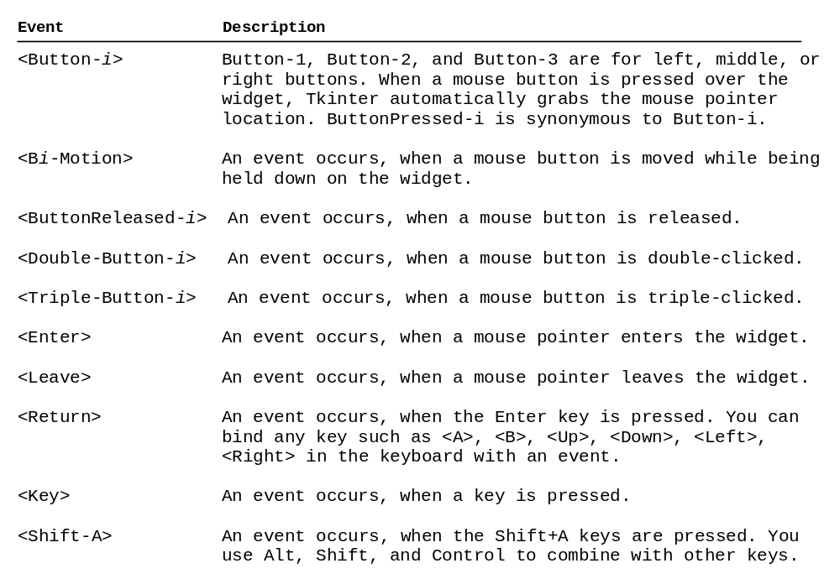
Events

Slide 26
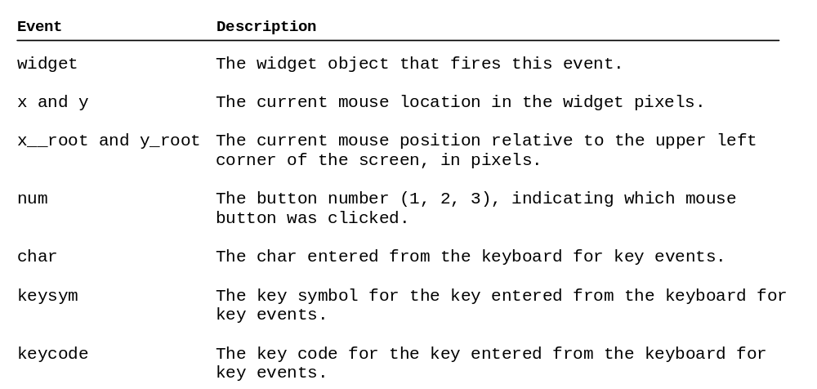
Event Properties

Slide 27
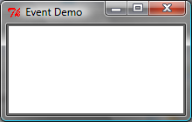
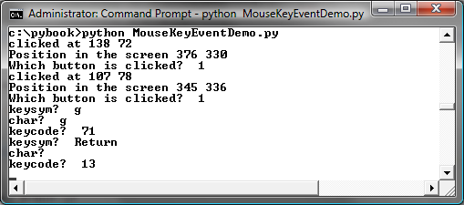
Mouse Key Event Demo
MouseKeyEventDemo
Run

Slide 28
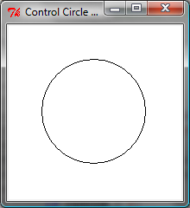
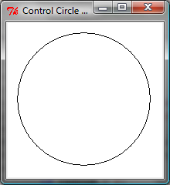
Control Circle Demo
ControlCircle
Run

Slide 29


Animations
AnimationDemo
Run

Slide 30
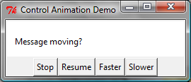
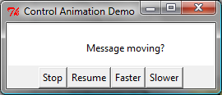
Control Animations
ControlAnimation
Run

Slide 31
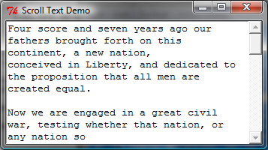
Scrollbar
ScrollText
Run

Slide 32
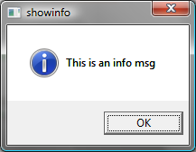
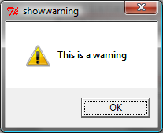
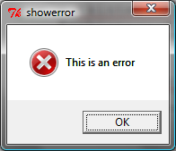
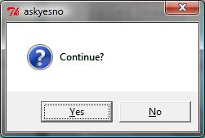
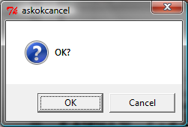
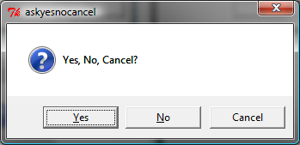
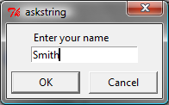
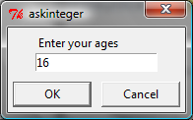
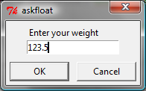
Standard Dialogs
DialogDemo
Run

